Slide 1
Big Data Analytics Project
Phase 1
11/10/2021

Slide 2

Group 2
Dhananjay Panchal
Nikhil R Pawar
Shubham Pawar
Yadhavi Rao
Jiazheng Yue

Slide 3
Jiazheng Yue
Member 4
Year- 1988

Slide 4
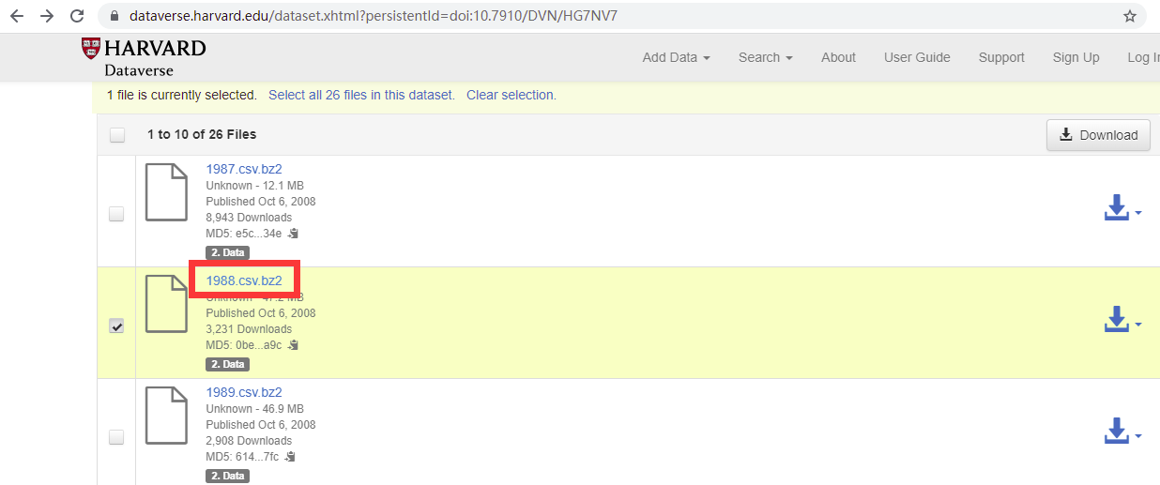
Data source: HARVARD dataverse
Notes:
I opened the given website and opened 1988.csv.bz2.

Slide 5
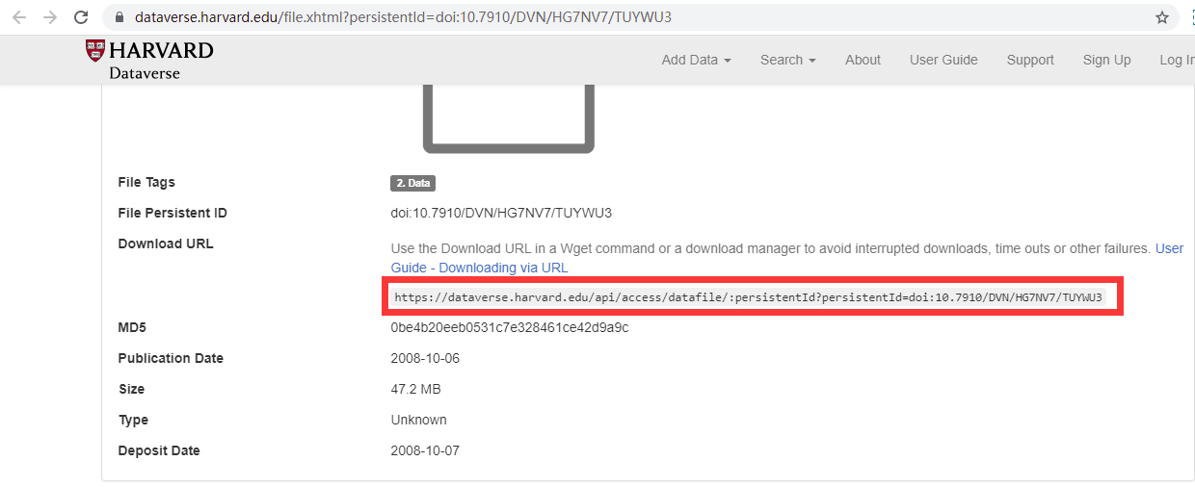
Data file: 1988.csv.bz2
Notes:
https://dataverse.harvard.edu/api/access/datafile/:persistentId?persistentId=doi:10.7910/DVN/HG7NV7/TUYWU3

Slide 6


Download the file:
Notes:
wget https://dataverse.harvard.edu/api/access/datafile/:persistentId?persistentId=doi:10.7910/DVN/HG7NV7/TUYWU3 –O 1988.csv.bz2

Slide 7
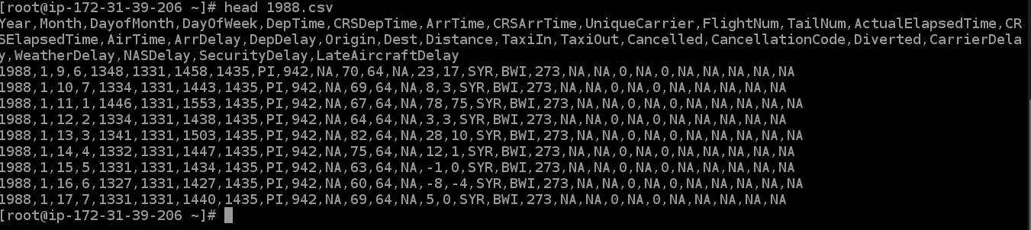
Show the head of the file:
Notes:
Head 1988.csv

Slide 8

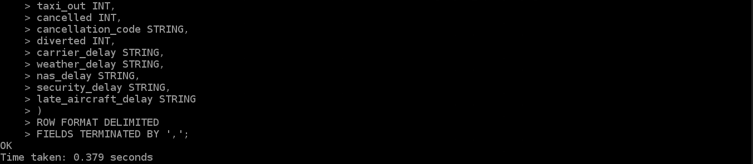
Load the data into a Hadoop table
Notes:
hive

Slide 9
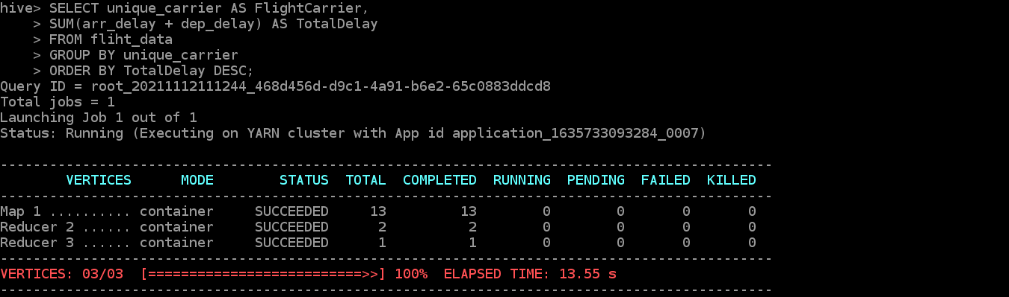

Determine the six carriers with the highest/lowest delay time (in hours) for 1988
Notes:
ls

Slide 10
Determine the six carriers with the highest/lowest delay time (in hours) for 1988
The six carriers with the highest delay time: UA, DL, US, PI, AA, CO
The six carriers with the lowest delay time: PS, PA, AS, HP, WN, TW
Notes:
ls

Slide 11
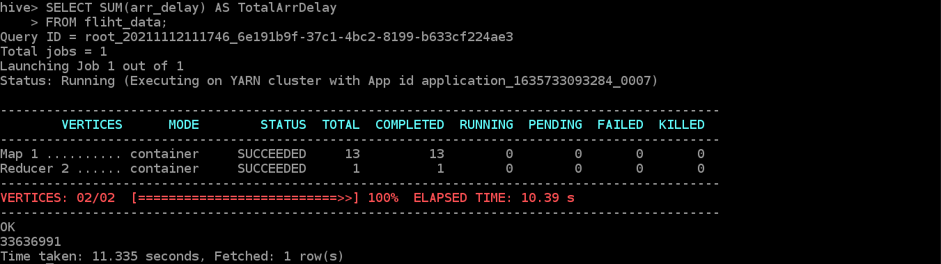
Determine, overall, which type of delay is the smallest contributor for your year, arrivals or departures
Determine the total arrival delay: 33636991

Slide 12
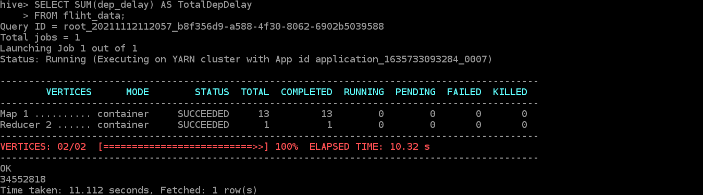
Determine, overall, which type of delay is the smallest contributor for your year, arrivals or departures
Determine the total departure delay: 34552818
total departure delay>total arrival delay, so arrivals is the smallest contributor for 1988.

Slide 13
Conclusion
The six carriers with the highest delay time (in hours) for 1988:
UA, DL, US, PI, AA, CO
The six carriers with the lowest delay time (in hours) for 1988:
PS, PA, AS, HP, WN, TW
Overall, the arrival delay is the smallest contributor for 1988.

Slide 14
Shubham Pawar
Member 3
Year- 1999

Slide 15

Downloaded File

Slide 16
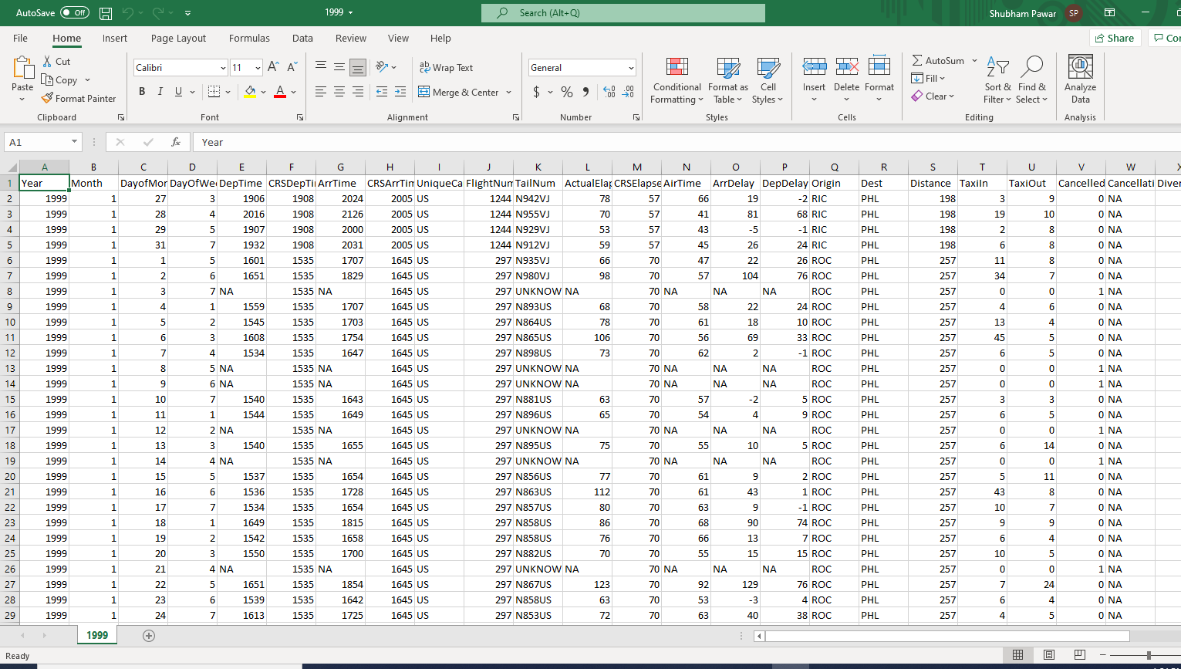
Excel Spreadsheet

Slide 17
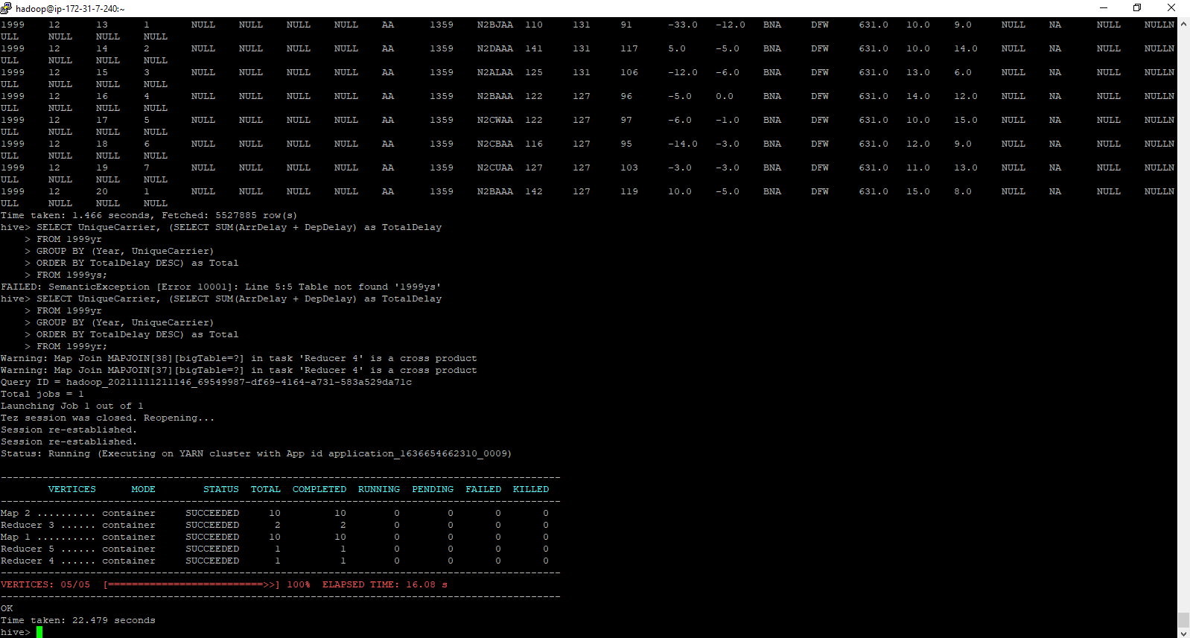
Script For Highest Delay

Slide 18

Output

Slide 19
1999 Highest Delay Airlines
The Airlines which experienced highest delay in the year 1999 were:
WN- Southwest Airline
UA- United Airlines
US - United Airlines
DL – Delta Airlines
AA – American Airlines
CO – Continental Airlines

Slide 20

Script For Lowest Delay

Slide 21

Output

Slide 22
1999 Lowest Delay Airlines
The Airlines which experienced Lowest delay in the year 1999 were:
AS - US. Airline codes
TW - Trans world airlines
HP - Hawaiian Airline (American West Airlines)
NW – Northwest Airlines
CO – Continental Airlines
AA – American Airlines

Slide 23

Output of Total Arrival and Departure Delay of All the Airlines
In the year 1999, the departure delay was the main contributor in the total delay. Arrival : 736698 Departure: 836226

Slide 24
Dhananjay Panchal
Member 1
Year- 2000

Slide 25
Downloaded File

Slide 26
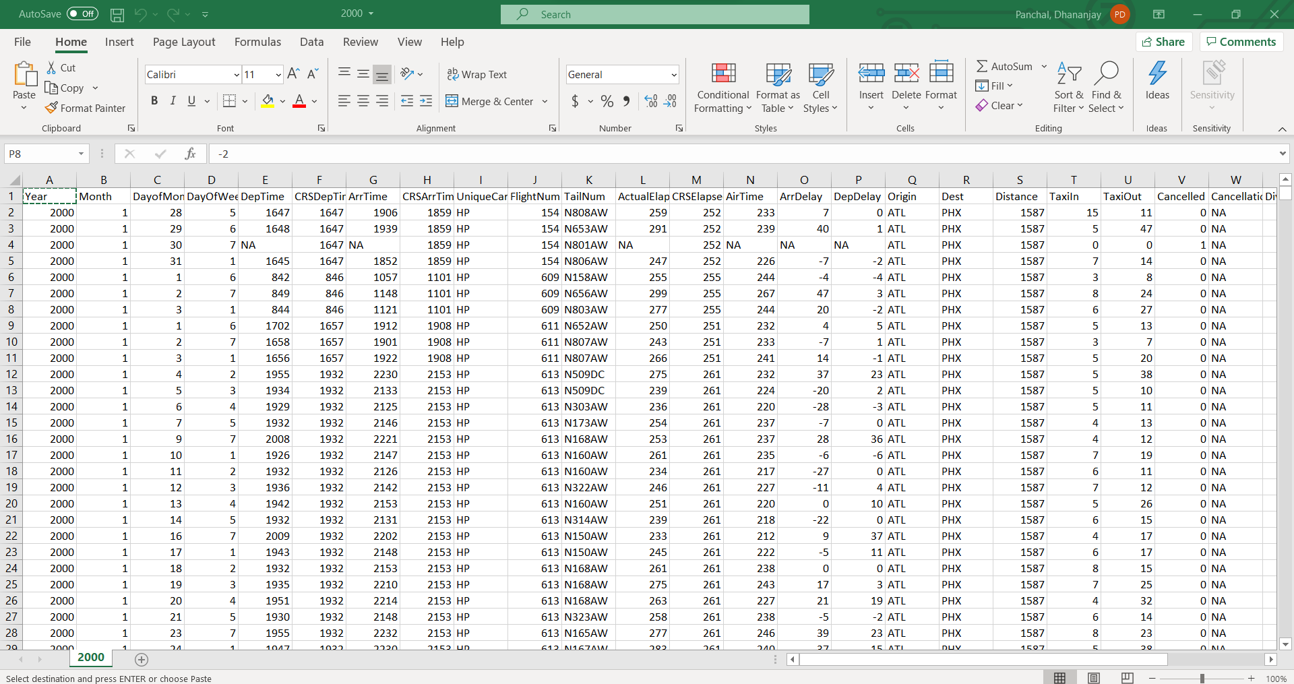
Spreadsheet Output

Slide 27
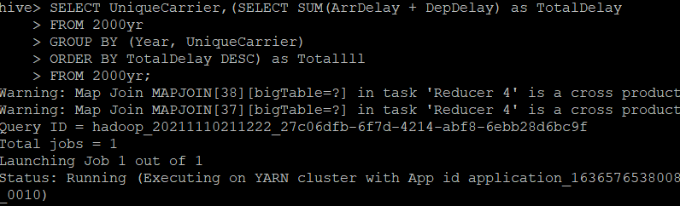
Script For Highest Delay

Slide 28

Output of Highest Delay

Slide 29
2000 Highest Delay Airline
The Airlines which experienced highest delay in the year 200 were:
1. UA - United Airlines
2. WN –Southwest Airlines
3. DL - Delta Airlines
4. AA – American Airlines
5 US - United Airlines
6 NW – Northwest Airlines

Slide 30
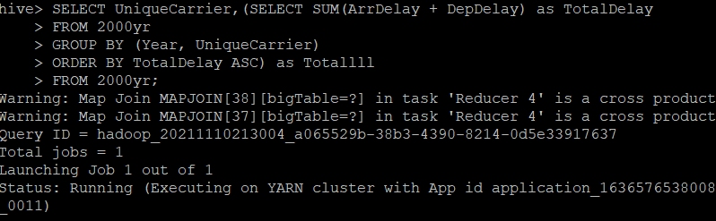
Script for Lowest Delay

Slide 31

Output of Lowest Delay

Slide 32
2000 Lowest Delay Airline
The Airlines which experienced lowest delay in the year 2000 were:
1. AQ – 9 Air Airlines
2. AS - Alaska Airlines
3. TW – Trans World Airlines
4 CO – Continental Airlines
5 HP - America West Airlines
6 NW – Northwest Airlines

Slide 33
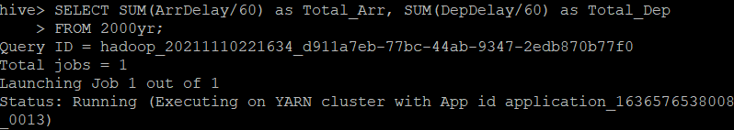

Output of Total Arrival and Departure Delay of All the Airlines
CODE
OUTPUT
In the year 2000, the departure delay was the main contributor in the total delay.

Slide 34
Yadhavi Rao
Member 2
Year- 2003

Slide 35
Downloaded File

Slide 36
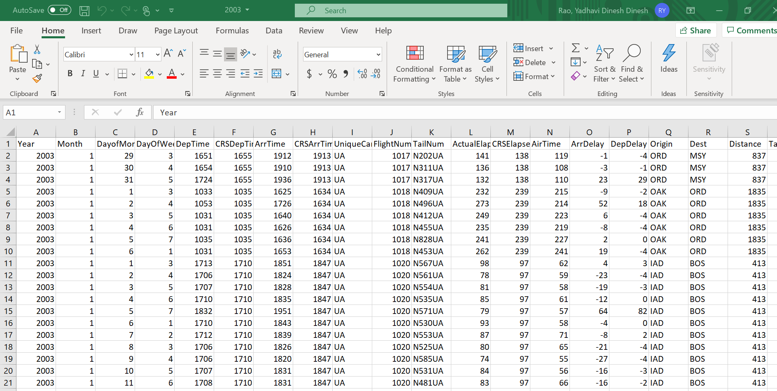
Spreadsheet Output

Slide 37
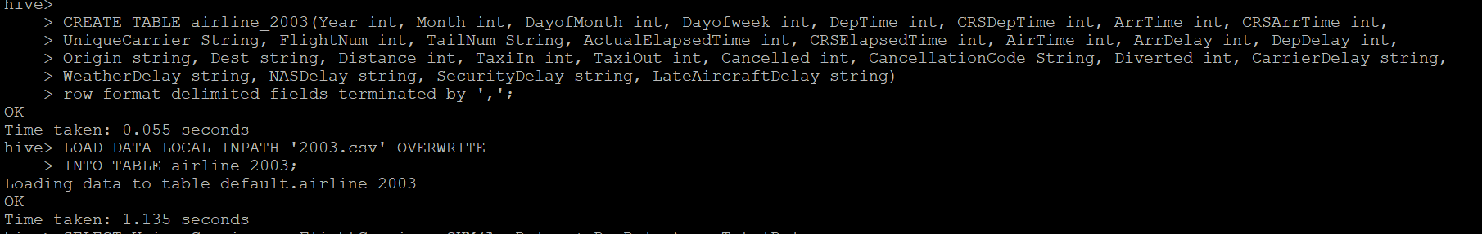
Created Table

Slide 38
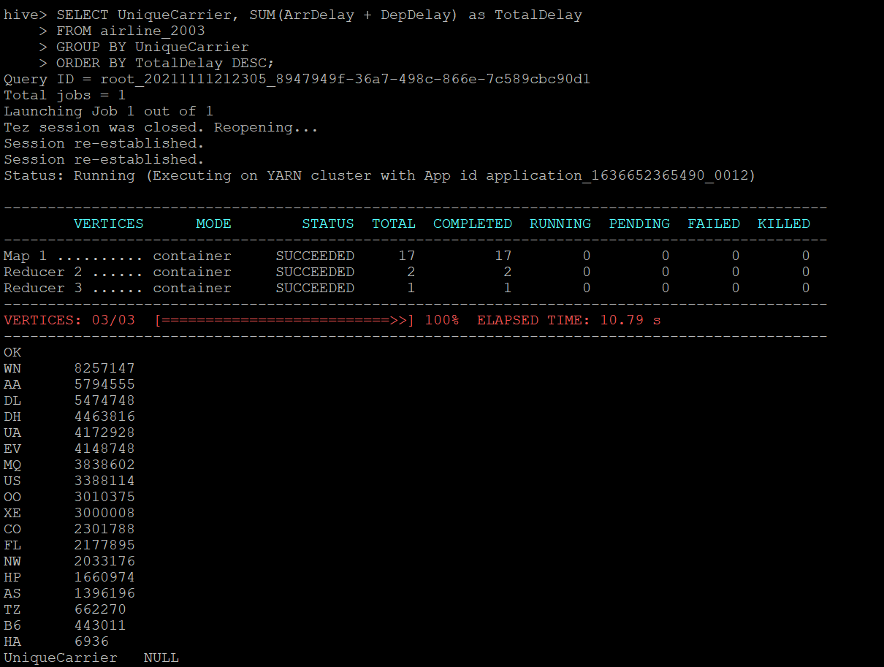
Script For Highest Delay and Output

Slide 39
2003 Highest Delay Airlines
The Airlines which experienced highest delay in the year 2003 were:
1. WN – Southwest Airlines
2. AA – American Airlines
3. DL – Delta Airlines
4. DH – Douniah Airlines
5. UA – United Airlines
6. EV – ExpressJet

Slide 40
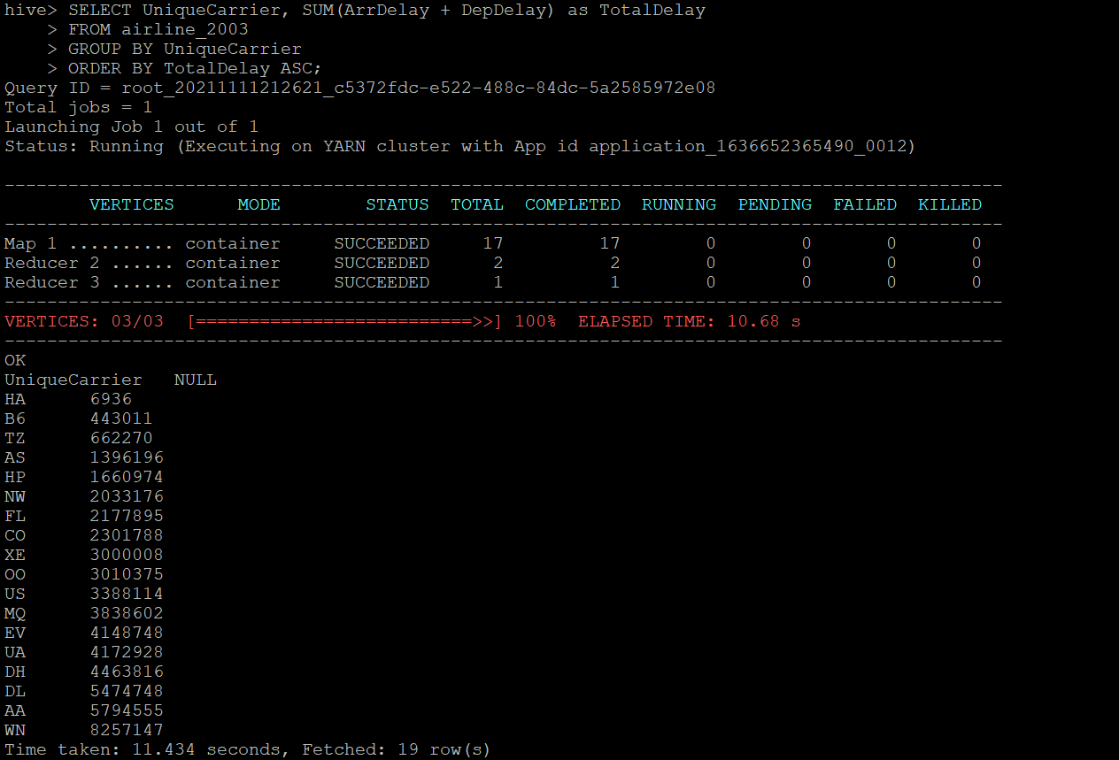
Script for Lowest Delay and Output

Slide 41
2003 Lowest Delay Airline
The Airlines which experienced highest delay in the year 2003 were:
1. HA – Hawaiian Airlines
2. B6 – JetBlue Airlines
3. AZ – Air Tanzania
4. AS – Alaska Airlines
5. HP – America West Airlines
6. NW – Northwest Airlines

Slide 42
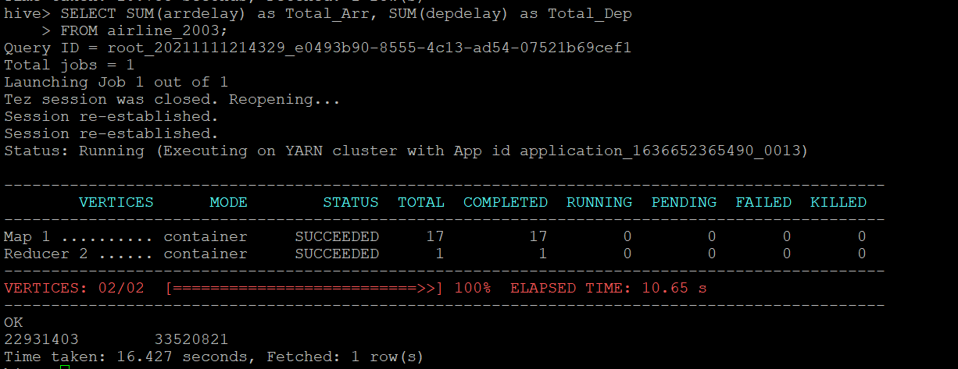
Output of Total Arrival and Departure Delay of All the Airlines
CODE
In the year 2003, the departure delay was the main contributor in the total delay. Arrival : 22931403 Departure: 33520821

Slide 43
Nikhil R Pawar
Member 4
Year- 2006

Slide 44
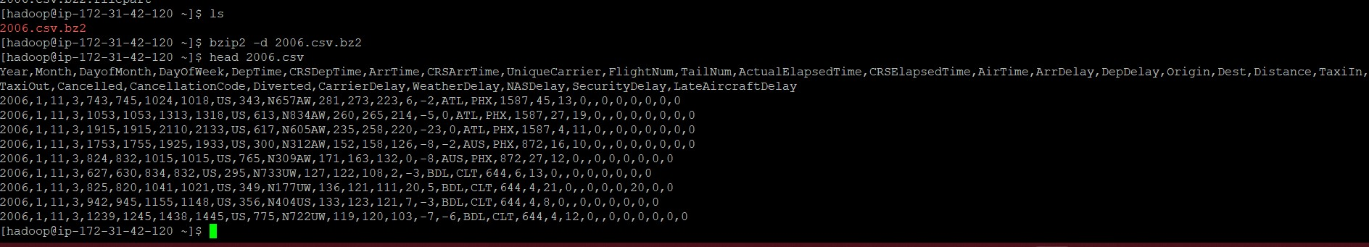
Year 2006 zip file
Above is 2006.csv data file in zip format
Unzip that file using bzip2 –d filename
We can view contents from that file as well

Slide 45
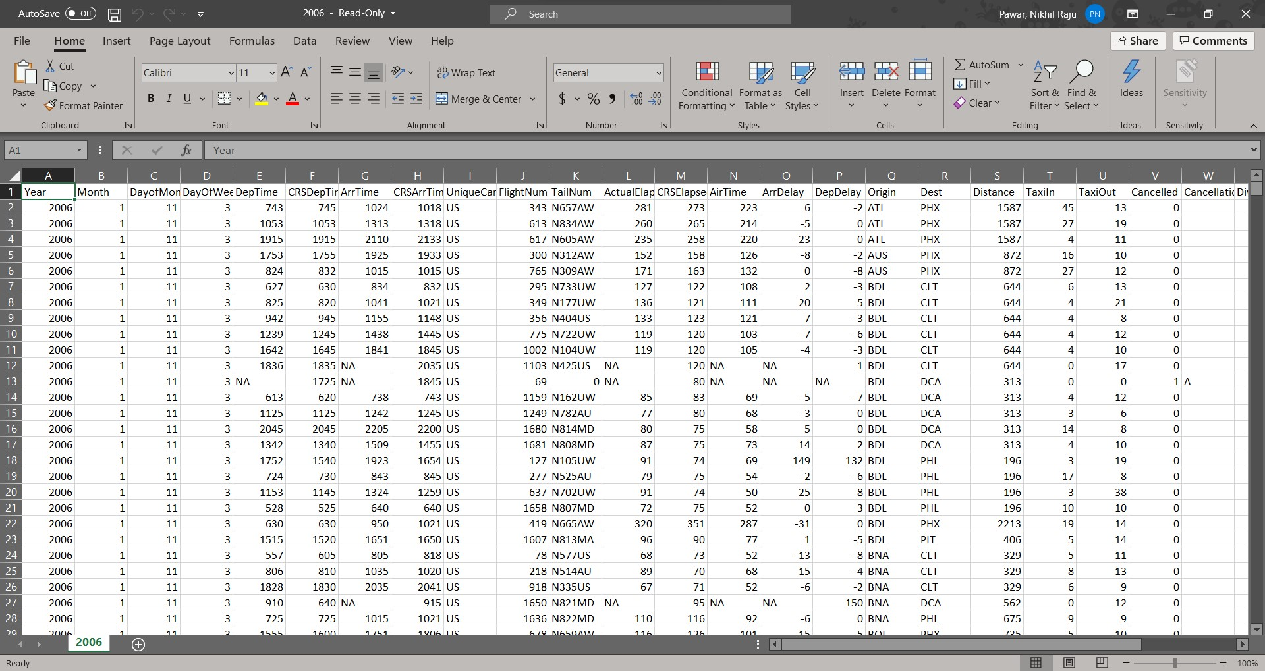
Spreadsheet Output

Slide 46
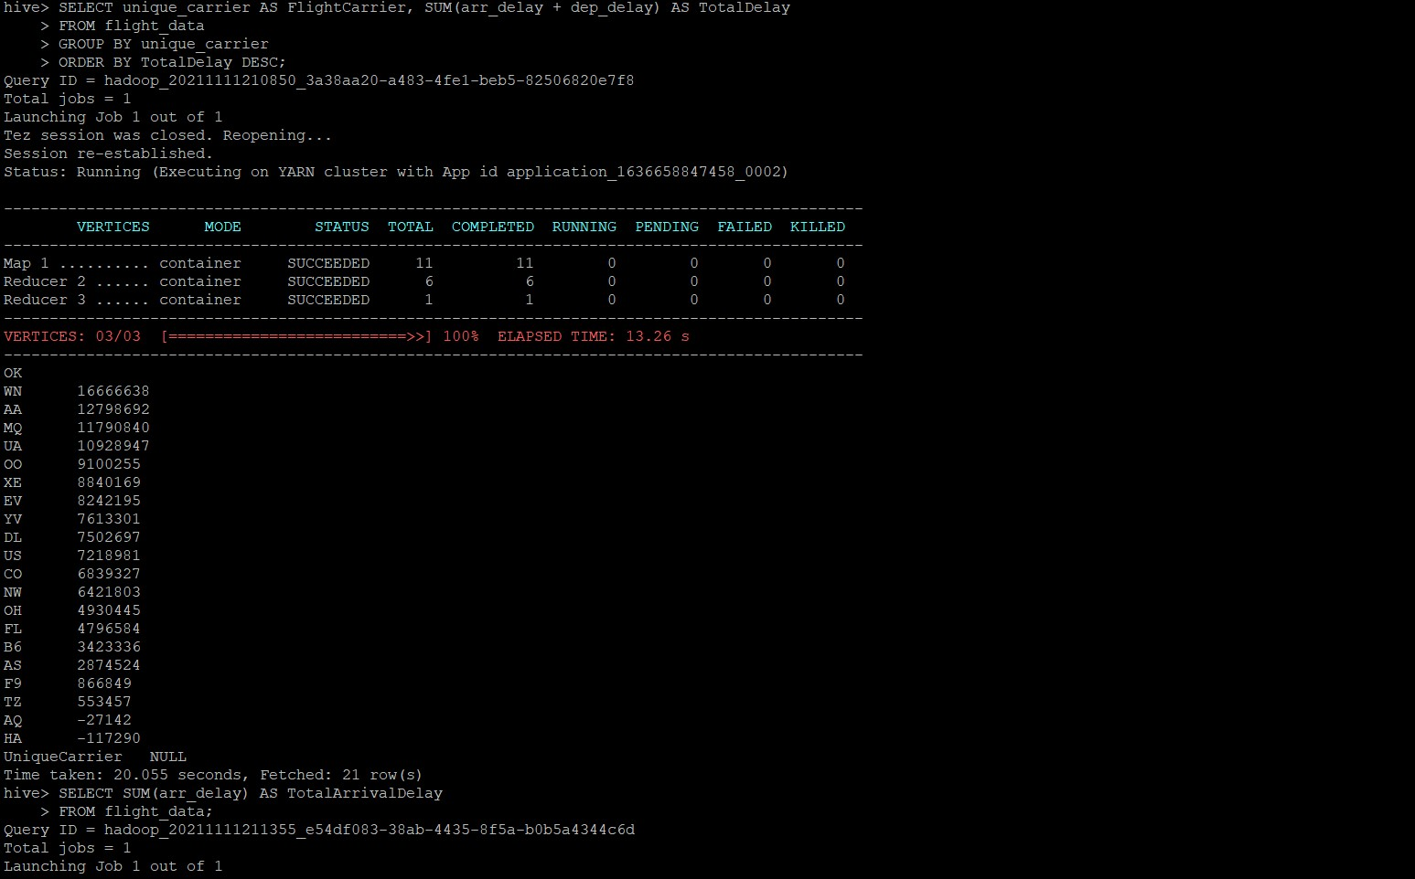
Delays

Slide 47
Highest delay of year 2006 WN (Southwest Airlines) = 16666638 Lowest delay of year 2006 HA (Hawaiian Airlines) = -117290

Slide 48
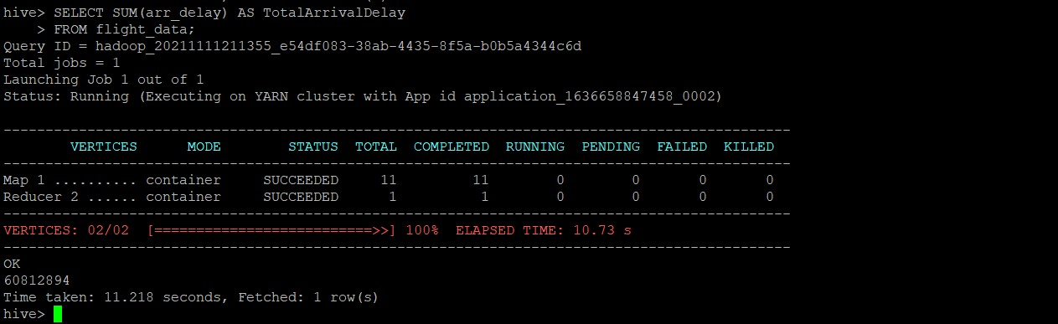
Total Delays And Comparison Arrival Delay

Slide 49
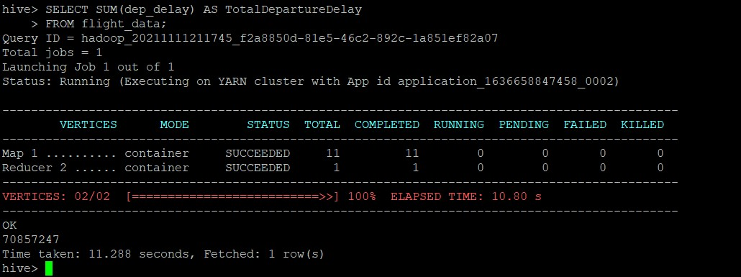
Departure Delay

Slide 50
From above I concluded that departure delay is more than arrival delay
Therefore, Departure delay is the largest contributor for year 2006

Slide 51
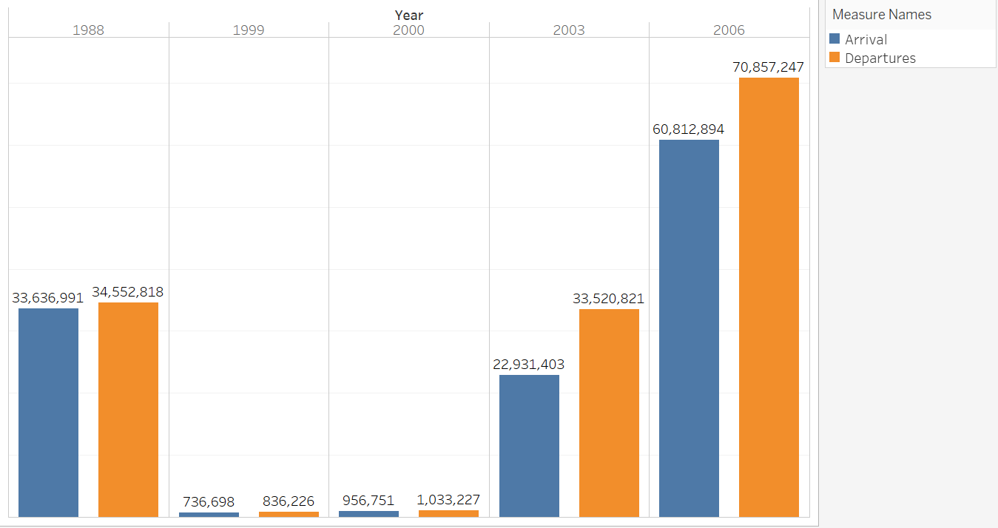

Slide 52
Thank You

